Slide 1
What Every Computational Physicist Should Know About Computer Architecture*
a[i]
a[i+1]
a[i+2]
a[i+3]
+
b[i]
b[i+1]
b[i+2]
b[i+3]
=
a[i]+b[i]
a[i+1]+b[i+1]
a[i+2]+b[i+2]
a[i+3]+b[i+3]
*Plus some other useful technology
Ian Cosden, Princeton University
Steve Lantz, Cornell University
CoDaS-HEP Summer School, August 1, 2022

Slide 2
Outline
Motivation
HPC Cluster
Compute
Memory
Disk
Other Architectures

Slide 3
Why Care About the Hardware?
Get the most out of this week
Be able to ask better questions and understand the answers
Architecture changes can force new design and implementation strategies
Prevent programming mistakes
Make educated decisions
Exploit the hardware to your advantage (performance)

Slide 4
Hardware is the Foundation
Application
User
Program
Programming Language
Programming Models
Compiler
Runtime Libraries
System
OS support for resource management (threading, memory, scheduling)
Shared Memory
Disk
Hardware
CPU
CPU
Accelerators
Network

Slide 5
Why Care About HPC Hardware?
High-Performance Computing (HPC)
Aggregate computing power in order to deliver far more capacity than a single computer
Supercomputers
Some problems demand it from the onset; many problems evolve to need it
When you outgrow your laptop, desktop, departmental server
Ask: do you need greater capability, or just capacity?
Either way, HPC clusters run lots of High-Throughput Computing (HTC) jobs
HPC
HTC

Slide 6
Moore’s Law
Number of transistors doubles ever 18-24 months
More transistors = better, right?
6

Slide 7
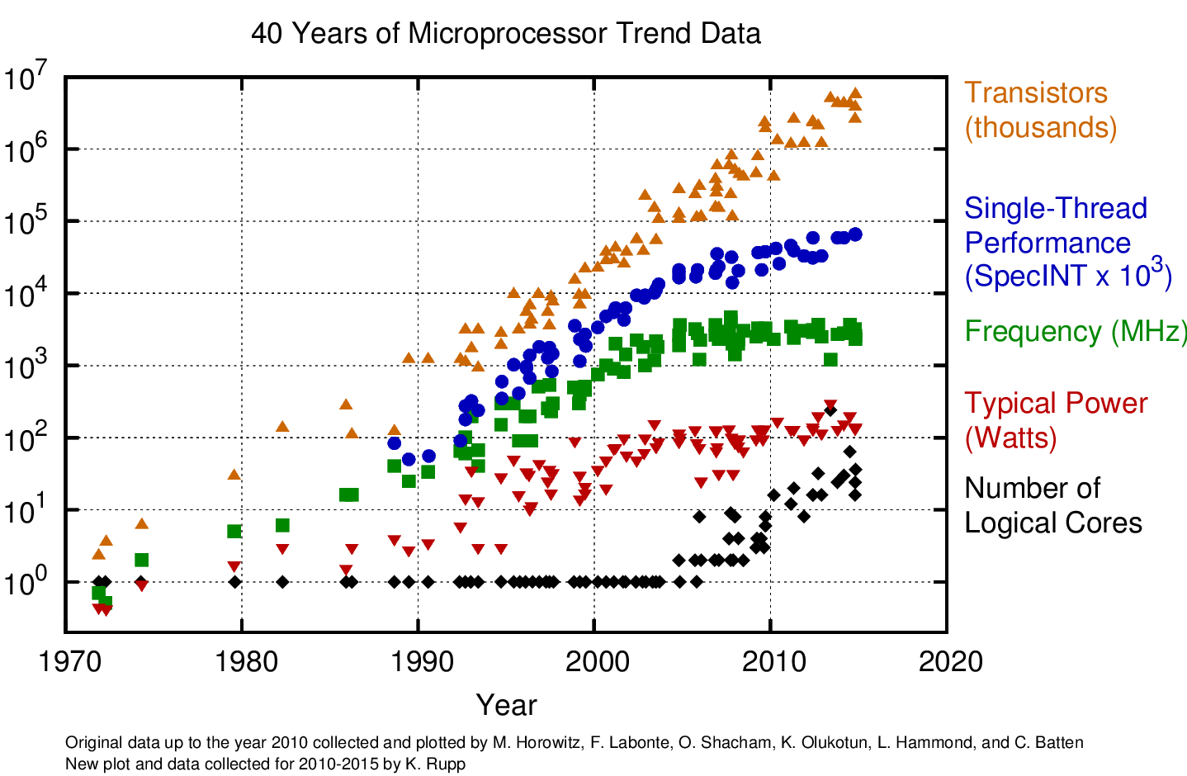
The Free Lunch is Over
Vectorization
The Free Lunch
Parallelization
https://www.karlrupp.net/2015/06/40-years-of-microprocessor-trend-data/

Slide 8
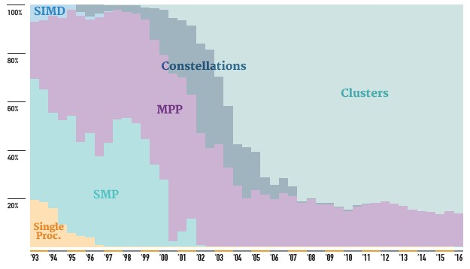
Top 500 Supercomputers
https://www.top500.org
https://www.nextplatform.com/2016/06/20/china-topples-united-states-top-supercomputer-user/

Slide 9
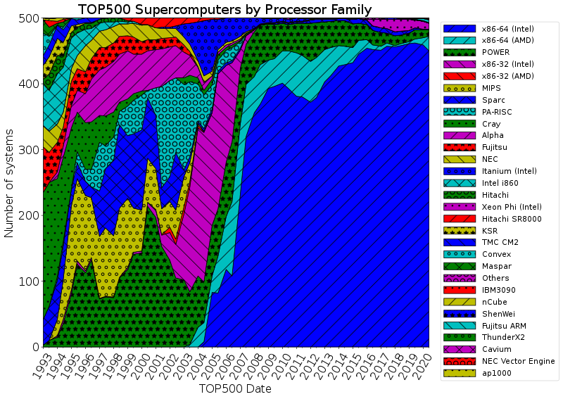
Why Talk About Intel Architecture?
https://en.wikipedia.org/wiki/TOP500

Slide 10
Outline
Motivation
HPC Cluster
Compute
Memory
Disk
Other Architectures

Slide 11
Zoom In On A Cluster
A cluster is just connected collection of computers called nodes
The high-speed network that connects the cluster is called the interconnect
A single, unconnected node is usually just called a server
Entire clusters, as well as stand-alone servers, are sometimes referred to as machines

Slide 12
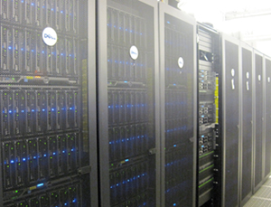
Parallel Computers
HPC Cluster: the vast majority of HPC systems
A collection of servers connected to form a single entity
Each is essentially a self-contained computer
OS with CPU, RAM, hard drive, etc.
Stored in racks in a dedicated machine room
Networked together a via low-latency interconnect
Ethernet < InfiniBand, Omni-Path (Intel)
Interconnect extends to shared storage
SMP System: Symmetric Multi-Processing
CPUs all share memory – essentially one computer
Expensive, likely needed for a unique purpose
Huge memory, huge OpenMP jobs
Princeton’s Della Cluster

Slide 13
Basic Cluster Layout
Compute Nodes
Scheduler
ssh
Your Laptop
Login Node(s)
Shared Storage
SWITCHES

Slide 14
Nodes Are Discrete Systems
Memory address space
Range of unique addresses
Separate for each node
Can’t just access all memory in cluster
Memory
Memory
Core
Core
Core
Core
Core
Core
Core
Core
Network
Memory
Memory
Core
Core
Core
Core
Core
Core
Core
Core
Each node has a separate address space

Slide 15
Clusters With Accelerators
“Heterogeneous” system architecture
Accelerators: GPUs, typically
Or FPGAs, etc.
Node can have multiple accelerators
Programmable with MPI + x
Where x = OpenMP, OpenACC, CUDA, …
Increases computational power
Increases FLOPS / Watt
Trending in Top500.org
Strong shift toward systems with accelerators started ~10 years ago
GPUs
GPUs
GPUs
GPUs

Slide 16
Outline
Motivation
HPC Cluster
Compute
Memory
Disk
Other Architectures

Slide 17
Multicore Processors
Nearly all modern processors are multicores
In servers: Intel Xeon, AMD EPYC, IBM Power
In laptops: Intel, AMD, ARM
In GPUs, phones, and mobile devices as well
Most have vector units, multiple cache levels
Require special care to program
Multi-threading, vectorization, …
The free lunch is over!
Instruction sets can vary
Intel and AMD: x86_64 base, not identical
IBM Power, ARM, NVIDIA, etc. all differ
Intel Skylake Architecture

Slide 18
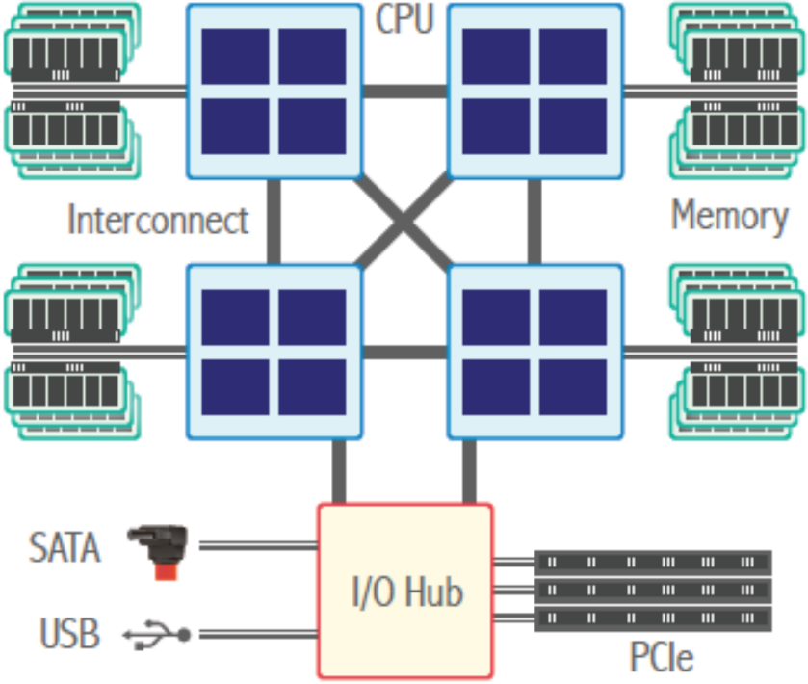
Motherboard Layout
Typical nodes have 1, 2, or 4 processors
1: laptop/desktops/servers
2: servers/clusters
4 (or more): high end special use
Each processor is attached to a socket
Each processor has multiple cores
CPU can refer to a core... or a processor
Processors connected via interconnect
Memory attached to processor/socket
Programmer sees single node memory address space
Processor
Core
Core
Core
Core
Interconnect
Intel: QPI/UPI
AMD: HT

Slide 19
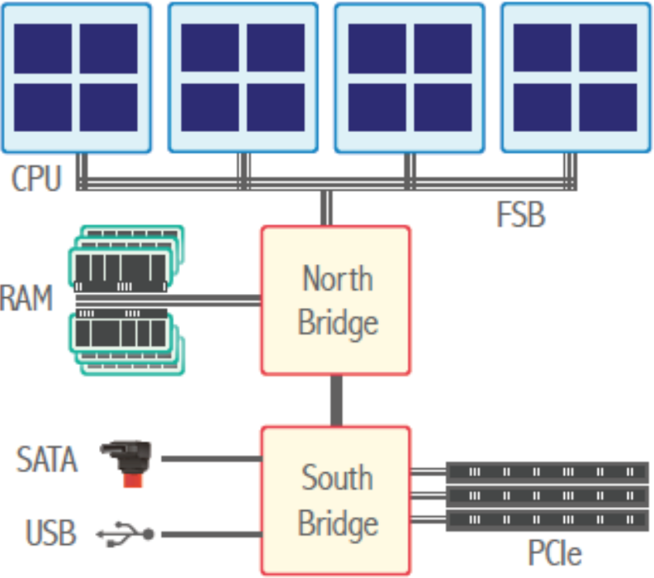
Motherboard Layouts, Past and Present
Intel QPI/UPI,
AMD HT
Symmetric MultiProcessing (SMP) –
Memory access is uniform, as all traffic goes via north bridge, but is bottlenecked by front side bus (FSB) and north-bridge-to-RAM bandwidth limitations. Current motherboards have no north bridge; the south bridge is now referred to as the I/O hub or just the chipset.
Non-Uniform Memory Access (NUMA) –
Physical memory is partitioned per CPU, with a fast interconnect to link CPUs to each other and to I/O.
This removes bottlenecks but memory is no longer uniform – there may be 30-50% extra latency to access remote memory, more in multi-hop systems.

Slide 20
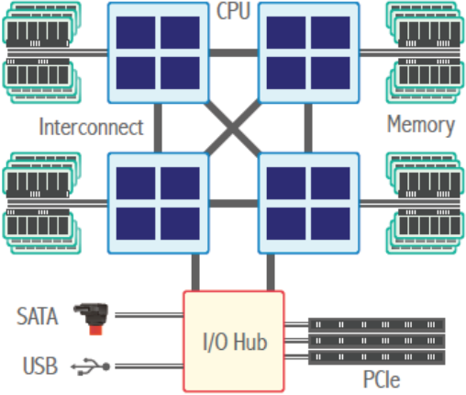
Example: Intel Skylake Scalable Processor
North Cap: UPI, PCIe,…
“System on a Chip” (SoC)
Core: “A complete ensemble of execution logic, and cache storage as well as register files plus instruction counter (IC) for executing a software process or thread.” (Jarp)
UPI – Intel Ultra Path Interconnect
PCIe – Peripheral Component Interconnect Express
DDR – Double Data Rate
Core
Core
Memory
Controller
DDR
Core
Core
Core
Core
Core
Core
Core
https://en.wikichip.org/wiki/intel/microarchitectures/skylake_(server)#High_Core_Count_.28HCC.29

Slide 21
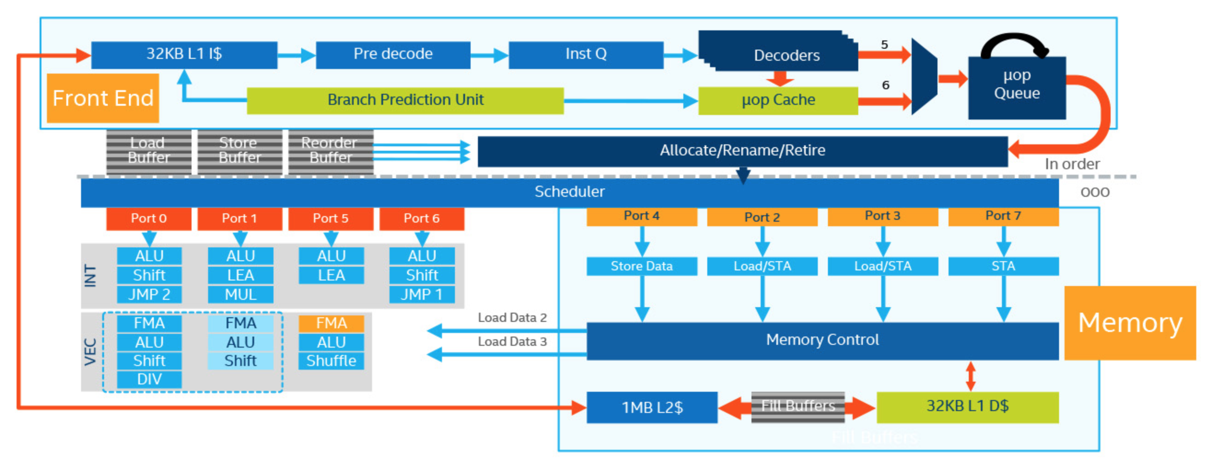
Skylake Core Microarchitecture
Too much!
Key Components:
Control logic
Register file
Functional Units
ALU (arithmetic and logic unit)
FPU (floating point unit)
Data Transfer
Load / Store

Slide 22
Vectorization Terminology
New generations of CPUs add capabilities and instructions
Each core can have one or more vector processing units (VPUs) and vector registers
Machine (assembly) commands are often added to take advantage of new hardware
Vector instructions are also called SIMD = Single Instruction Multiple Data
x86_64 has Streaming SIMD Extensions (SSE), Advanced Vector Extensions (AVX)
Scalar (SISD)
Vector (SIMD)
a[i]
a[i]
a[i+1]
a[i+2]
a[i+3]
+
+
At inner-most loop level
for (int i=0; i<N; i++) {
c[i]=a[i]+b[i]; }
b[i]
b[i]
b[i+1]
b[i+2]
b[i+3]
=
=
a[i]+b[i]
a[i]+b[i]
a[i+1]+b[i+1]
a[i+2]+b[i+2]
a[i+3]+b[i+3]
One operation
One result
One operation
Multiple results

Slide 23

HPC Performance Metrics
FLOP = Floating-point Operation
FLOPs = Floating-point Operations
FLOPS = Floating-point Operations Per Second
Often write FLOP/s or FLOP/sec to avoid ambiguity
Calculation for single processor
Typically Double Precision (64-bit)
FLOPS = (Clock Speed)*(Cores)*(FLOPs/cycle)
FLOPS/$, FLOPS/Watt are useful metrics too
Bandwidth metrics (“giga” usually means 10⁹)
GB/s = gigabytes/sec
Gb/s = gigabits/sec
N.B. - not to be confused with a Hollywood flop!
Notes:
1999 Film
Lost ~100 million

Slide 24
Intel Xeon (Server) Architecture Codenames
Number of FLOP/s depends on width, number, and abilities of VPUs in a core
Per-core rates, double precision (64-bit doubles – twice this for 32-bit floats)
Pentium 4*… Nehalem/Westmere (SSE2… SSE4):
4 DP FLOPs/cycle: 128-bit addition + 128-bit multiplication
Sandy Bridge/Ivy Bridge (AVX)
8 DP FLOPs/cycle: 256-bit addition + 256-bit multiplication
Haswell/Broadwell (AVX2)
16 DP FLOPs/cycle: two, 256-bit FMA, fused multiply-add
KNL/Skylake (AVX-512)
32 DP FLOPs/cycle: two**, 512-bit FMA
Cascade Lake (AVX-512 VNNI with INT8)
32 DP FLOPs/cycle: two, 512-bit FMA
ADD MUL
2x
2x
2x
*Pentium III (1999) introduced 128-bit SSE for 4 single-precision floats
**Some Skylake-SPs can do only one 512-bit FMA = (a × b + c), per core
Notes:
Intel Deep Learning Boost (VNNI) provides significant, more efficient deep learning inference acceleration
Combines three AVX-512 instructions (VPMADDUBSW, VPMADDWD, VPADDD) into a single VPDPBUSD operation

Slide 25
Intel Xeon (Server) Architecture Codenames
Number of FLOP/s depends on width, number, and abilities of VPUs in a core
Per-core rates, double precision (64-bit doubles – twice this for 32-bit floats)
Nehalem/Westmere (SSE):
4 DP FLOPs/cycle: 128-bit addition + 128-bit multiplication
Sandy Bridge/Ivy Bridge (AVX)
8 DP FLOPs/cycle: 256-bit addition + 256-bit multiplication
Haswell/Broadwell (AVX2)
16 DP FLOPs/cycle: two, 256-bit FMA, fused multiply-add
KNL/Skylake (AVX-512)
32 DP FLOPs/cycle: two*, 512-bit FMA
Cascade Lake (AVX-512 VNNI with INT8)
32 DP FLOPs/cycle: two, 512-bit FMA
2x
2x
2x
*Pentium III (1999) introduced 128-bit SSE for 4 single-precision floats
**Some Skylake-SPs can do only one 512-bit FMA = (a × b + c), per core
Notes:
Intel Deep Learning Boost (VNNI) provides significant, more efficient deep learning inference acceleration
Combines three AVX-512 instructions (VPMADDUBSW, VPMADDWD, VPADDD) into a single VPDPBUSD operation

Slide 26
Outline
Motivation
HPC Cluster
Compute
Memory
Layout
Cache
Performance
Disk
Other Architectures

Slide 27
Memory Hierarchy
Dual Socket Intel Xeon CPU
CPU 1
CPU 2
Main Memory (DRAM)
Main Memory (DRAM)
L2
L3
L3
L2
Core
1
L1
L1
Core
1
Core
2
L1
L2
L2
L1
Core
2
…
…
Core
n
L1
L2
L2
L1
Core
n
UPI
 | Registers | L1 Cache | L2 Cache | L3 Cache | DRAM | Disk
Speed | 1 cycle | ~4 cycles | ~10 cycles | ~30 cycles | ~200 cycles | 10ms
Size | < KB per core | ~32 KB per core | ~256 KB per core | ~35 MB per socket | ~100 GB per socket | TB
Notes:
DDR4 – Double data rate 4th generation (Synchronous dynamic RAM)
UPI – UltraPath Interconnect (Intel) Skylake shifted more L2 cache from shared L3 cache (L2 ~1MB)

Slide 28
Growth in Memory Performance Lags CPU
Gap grows at 50% per year!
If your data is served by RAM and not caches it doesn’t matter if you have vectorization.
To increase performance, try to minimize memory footprint.
http://web.sfc.keio.ac.jp/~rdv/keio/sfc/teaching/architecture/architecture-2008/hennessy-patterson/Ch5-fig02.jpg
Notes:
Memory gap increases…
What do you think should require more attention?

Slide 29
Outline
Motivation
HPC Cluster
Compute
Memory
Disk
Types
Filesystems
Other Architectures

Slide 30
File I/O
“A supercomputer is a device for turning compute-bound problems into I/O-bound problems.”
-- Ken Batcher, Emeritus Professor of Computer Science at Kent State University

Slide 31
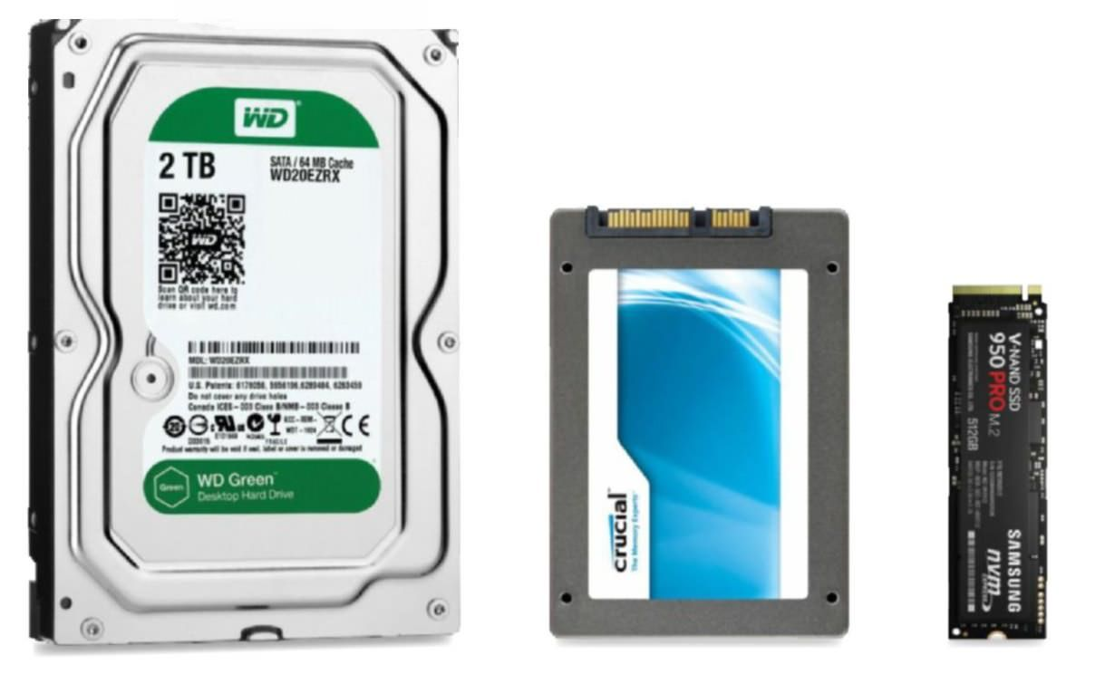
Types of Disk
Hard Disk Drive (HDD)
Traditional Spinning Disk
Solid State Drives (SSD)
~5x faster than HDD
Non-Volatile Memory Express (NVMe)
~5x faster than SSD
Photo Credit: Maximum PC

Slide 32
Types of Filesystems - NFS
NFS – Network File System
Simple, cheap, and common
Single filesystem across network
Not well suited for large throughput
Head node
Storage
Comp node 001
Storage
Comp node 002
NFS Server
...
...
Storage
Comp node N
≤ 8 storage devices

Slide 33
Parallel Filesystems
GPFS (General Parallel Filesystem – IBM)
Designed for parallel read/writes
Large files spread over multiple storage devices
Allows concurrent access
Significantly increase throughput
Lustre
Similar idea
Different implementation
Parallel I/O library in software
Necessary for performance realization
Head node
Object Storage
Storage
File A 1/3
Comp node 001
Storage
Comp node 002
File A 2/3
...
...
File A
Storage
Comp node N
File A 3/3
GPFS Servers
1,000s of storage devices

Slide 34
Outline
Motivation
HPC Cluster
Compute
Memory
Disk
Other Architectures
GPUs
Xeon Phi
Cloud

Slide 35
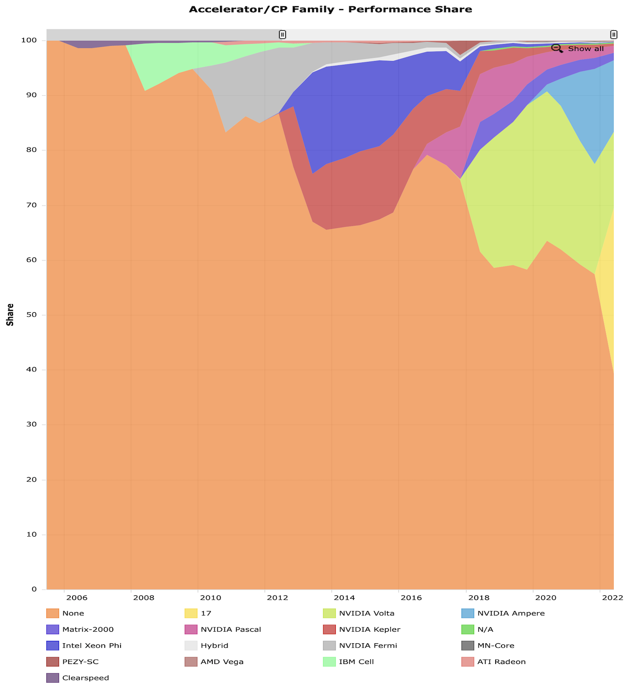
Heterogeneous Systems on the Rise
The computing landscape changes rapidly
60% of TOP500 systems now have accelerators (June 2022)
Graphics processing units (GPUs) are by far the most common type of accelerator
https://www.top500.org/statistics
Notes:
NVIDIA P100, Intel Xeon Phi

Slide 36
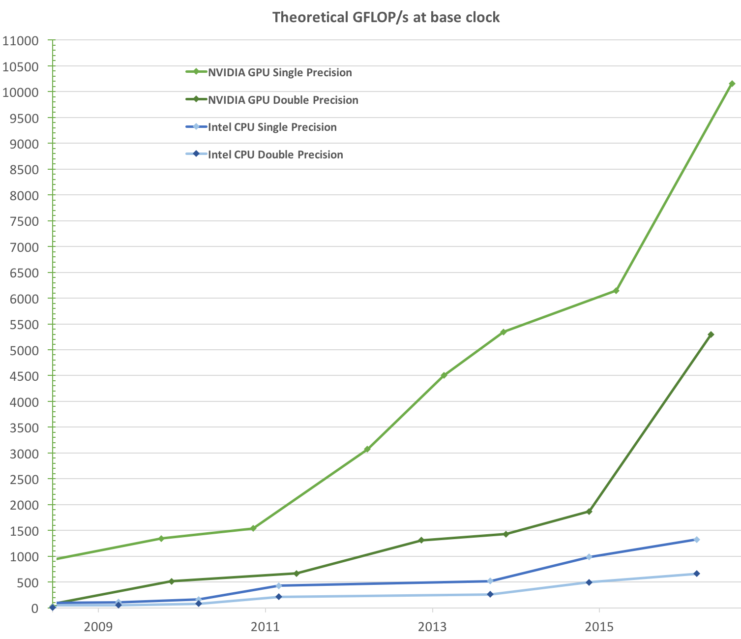
GPU and CPU Performance Trends
https://docs.nvidia.com/cuda/archive/9.1/pdf/CUDA_C_Programming_Guide.pdf

Slide 37
General Purpose GPUs
General Purpose GPU (GPGPU)
NVIDIA Pascal/Volta/Ampere…
AMD Radeon Instinct, others
Always attached to a CPU host
Data travels to device over PCIe
NVIDIA NVLink has higher speed
Not compatible with x86
Programmable sort-of-like CPUs
NVIDIA CUDA: extensions to C++
OpenCL, OpenACC, OpenMP, …
Need compatible compiler, libraries
NVIDIA Volta V100

Slide 38
NVIDIA Tesla V100 (V for “Volta”)
80 Streaming Multiprocessors (SMs)
Analogous to CPU cores
Execute only SIMD-type instructions
One SM holds many “CUDA cores”
Analogous to vector lanes
64 FP32 CUDA cores
64 INT32 CUDA cores
32 FP64 CUDA cores
One SM also has 8 tensor cores
Fast 4x4 matrix multiplications in FP16
Device memory: 32 GB of HBM2
Notes:
LD/ST units
FP16 @ 2x SP rate
cc7.0:
TensorCore
4 warp schedulers
Each warp scheduler is dual issue capable
P100: 50 SM’s, 16GB
V100: 80 SM’s, 16/32GB

Slide 39
NVIDIA Execution Model
SIMT = Single Instruction Multiple Thread
Operations apply to “warps” of 32 threads
A warp of threads is like a CPU vector
Not all that different from SIMD
CUDA core = scalar (thread) processor
Instructions only go to groups of 32
A thread block must be split into warps of 32
Thus, an SM is like 1 or 2 vector units in a CPU
One thread block maps to one SM
A grid of thread blocks can be spread over the entire device
Notes:
LD/ST units
FP16 @ 2x SP rate
cc7.0:
TensorCore
4 warp schedulers
Each warp scheduler is dual issue capable
P100: 50 SM’s, 16GB
V100: 80 SM’s, 16/32GB

Slide 40
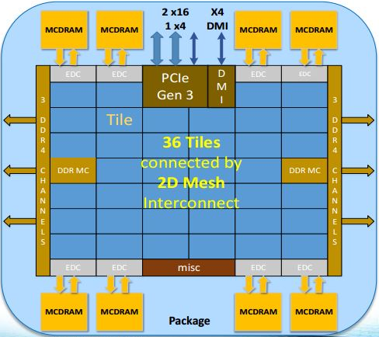
R.I.P. Intel Xeon Phi, a.k.a. Intel MIC
MIC: Many Integrated Cores
x86-compatible multiprocessor architecture
Programmable just CPUs
MPI, OpenMP, OpenCL, …
Same compilers as CPUs
But many cores, fast MCDRAM like GPUs
Intel’s “answer” to the GPU challenge
Started out as a coprocessor
Data travels over PCIe
Became main processor in 2nd generation
Eventually merged into Xeon line

Slide 41
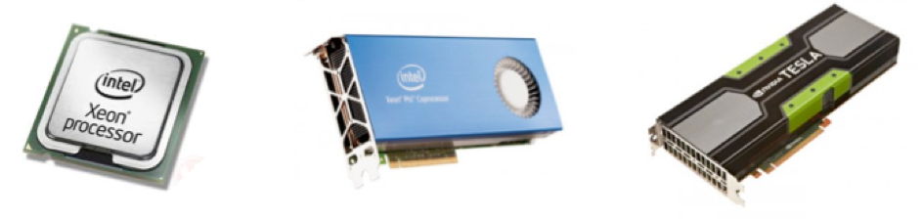
Processors vs. PCIe Devices, Circa 2019
M. Lefebvre
 | Xeon Gold 5122 (2017) | Xeon Platinum 8280M (2019) | Xeon Phi 7290F (2017) | NVIDIA V100 (2017)
Cores | 4 | 28 | 72 | 84 SMs
Logical Cores | 8 | 56 | 288 | 5120 cores
Clock rate | 3.6 – 3.7 GHz | 2.5 – 3.8 GHz | 1.5-1.7 GHz | 1530 MHz
Theoretical GFLOPS (double) | 460.8 | 2240 | 3456 | 7450
SIMD width | 512 bit | 512 bit | 512 bit | Warp of 32 threads
Memory | -- | -- | 16 GB MCDRAM 384 GB DDR4 | 32 GB
Memory B/W | 127.8 GB/s | 127.8 GB/s | 400+ GB/s MCDRAM 115.2 GB/s RAM | 900 GB/s
Approx. Unit Price | $1,200 | $12,000 | $3,400 | $9,000
Notes:
https://www.v-t.co.jp/product/wp-content/uploads/sites/2/2017/09/Skylake-SP_Feature_092017.pdf
Choice of xeon is arbitrary (actually depends on the data I could find)

Slide 42
Demystifying the Cloud
“Regular” computers, just somewhere else
Provide users with remote virtual machines or containers
Can be used for anything:
Mobile services, website hosting, business applications, …
Data analysis, high performance computing
Providers
Amazon Web Services (AWS)
Microsoft Azure
Google Cloud Platform (GCP)
Oracle Cloud
Lots of others

Slide 43
Cloud Computing Pros and Cons
Advantages:
Potentially lower cost
Pay as you go
Save on sysadmins and infrastructure
Economy of scale
Scaling up or down as needed
Can be used to run overflow from a regular data center
Access to a wide range of hardware
Challenges:
Data movement
Expensive and time consuming
Security, privacy, …
Notes:
Notice the “potentially”s

Slide 44
What We Didn’t Talk About
Microarchitecture details (ALU, FPU, pipelining…)
Memory bandwidth and latency
Cache lines and cache coherence
IBM (Power) or AMD processors
FPGAs, Google TPUs, NPUs, …

Slide 45
Resources & References
Very nice glossary: https://cvw.cac.cornell.edu/main/glossary
J. Hennessy, D. Patterson, Computer Architecture: A Quantitative Approach, 6th edition (2017), ISBN 978-0128119051
U. Drepper, What Every Programmer Should Know About Memory, http://people.redhat.com/drepper/cpumemory.pdf
NVIDIA Volta Architecture Whitepaper https://images.nvidia.com/content/volta-architecture/pdf/volta-architecture-whitepaper.pdf
Notes:
Bit.ly/2019-comp-arch

